Slide 1

Crazy about
(OpenStreet)Mapping

Slide 2
Who am I?
Pieter Vander Vennet
Studied informatics
Heavy OSM-contributor
Working for a small company on mobility (with OSM)
Bit crazy about mapping and OSM…
… I’ll tell you why

Slide 3
What is
OpenStreetMap?

Slide 4


Slide 5


Slide 6
What is
OpenStreetMap?

Slide 7
Geospatial data

Slide 8
Geospatial data
Lines and dots
+
Some information
on each line and dot

Slide 9
What is
OpenStreetMap?

Slide 10

Freedom to add data

Slide 11
Freedom to add data
As long as it is verifiable on the ground
As long as it is somewhat permanent
As long as no copyright is infringed
Go add your specific needs!

Slide 12

Freedom to add data

Slide 13
What is
OpenStreetMap?

Slide 14
Crowdsourced

Slide 16


Slide 17


Slide 18


Slide 19


Slide 20


Slide 21


Slide 22
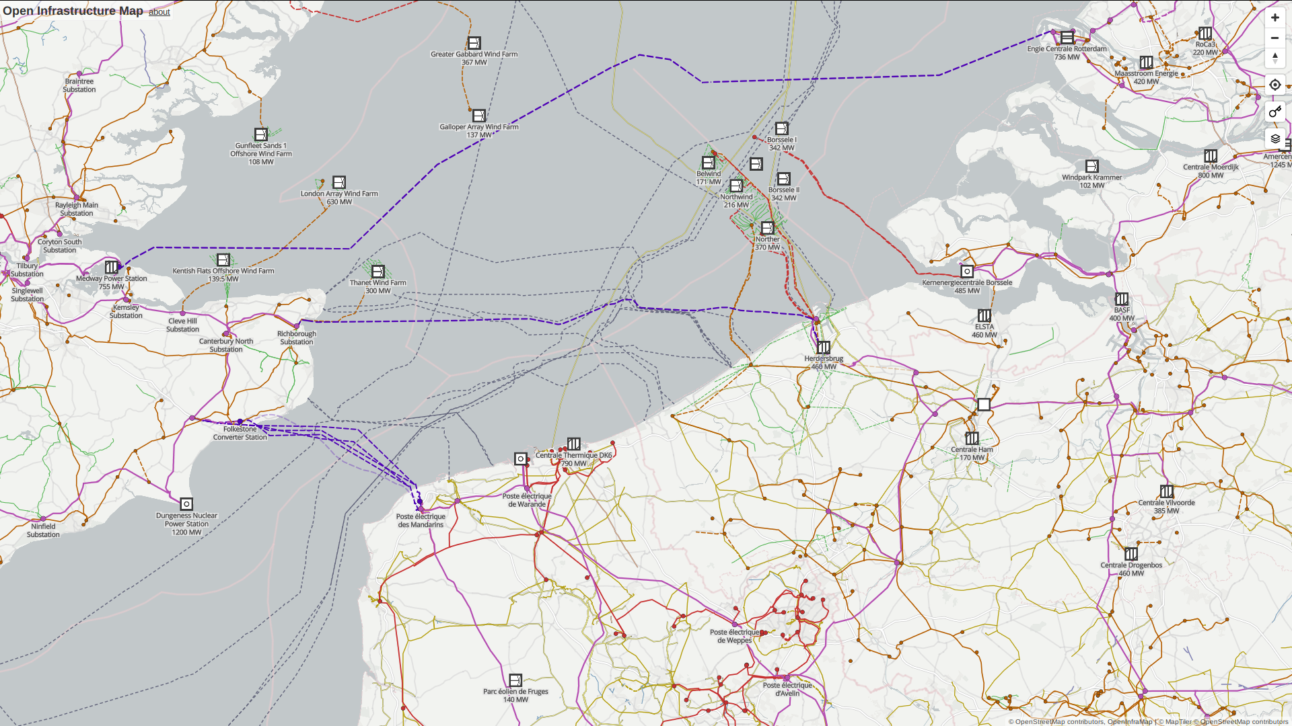

Slide 23
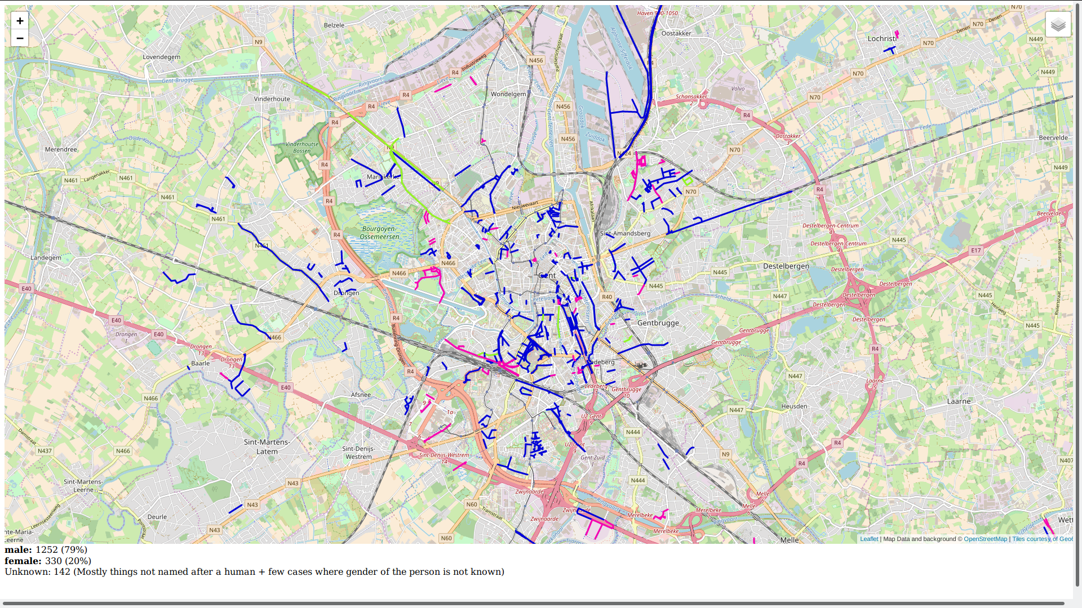


Slide 24
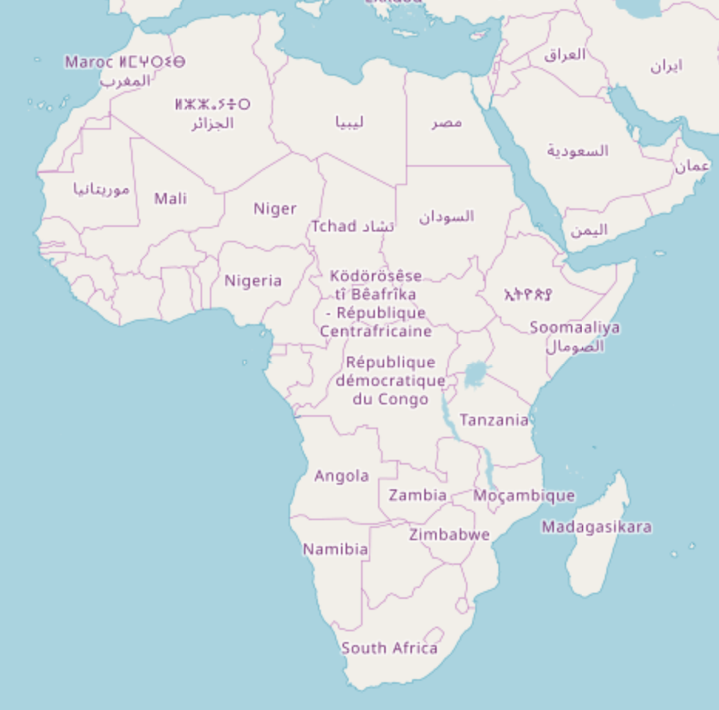

Slide 25


Slide 26



Slide 27
Saving lives

Slide 28
What is
OpenStreetMap?

Slide 29

A license: ODbL
Open Database License
You can use the data how you like
as long as you give attribution
and keep the data open

Slide 30
Tons of apps, websites, ...

Slide 31




OsmAnd

Slide 32
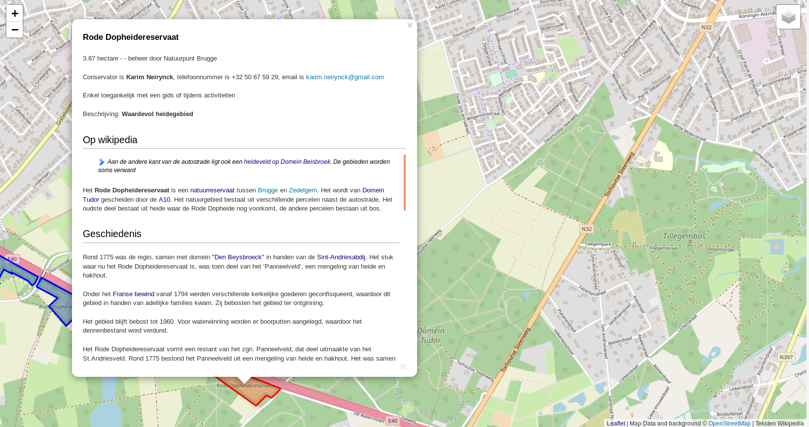


Slide 33

https://demo.f4map.com

Slide 34

https://demo.f4map.com

Slide 35
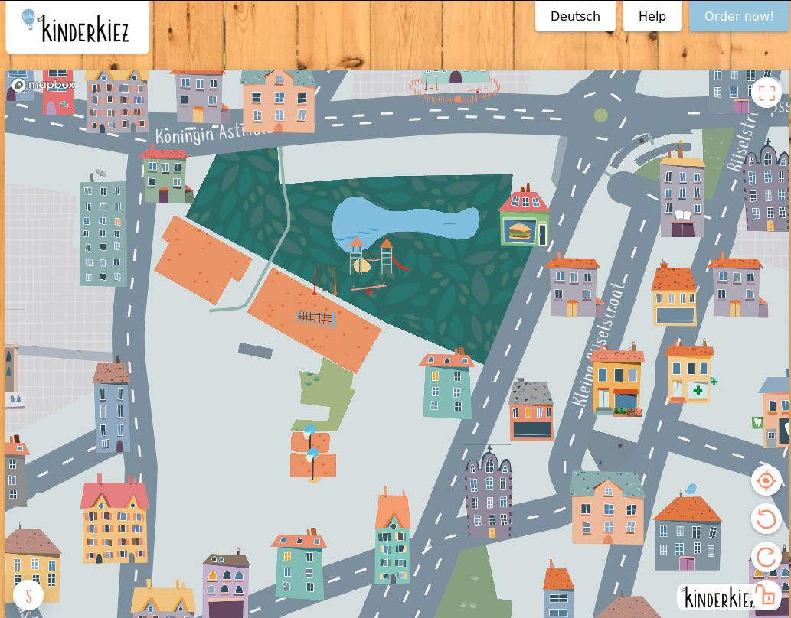
https://kinderkiez.net

Slide 36
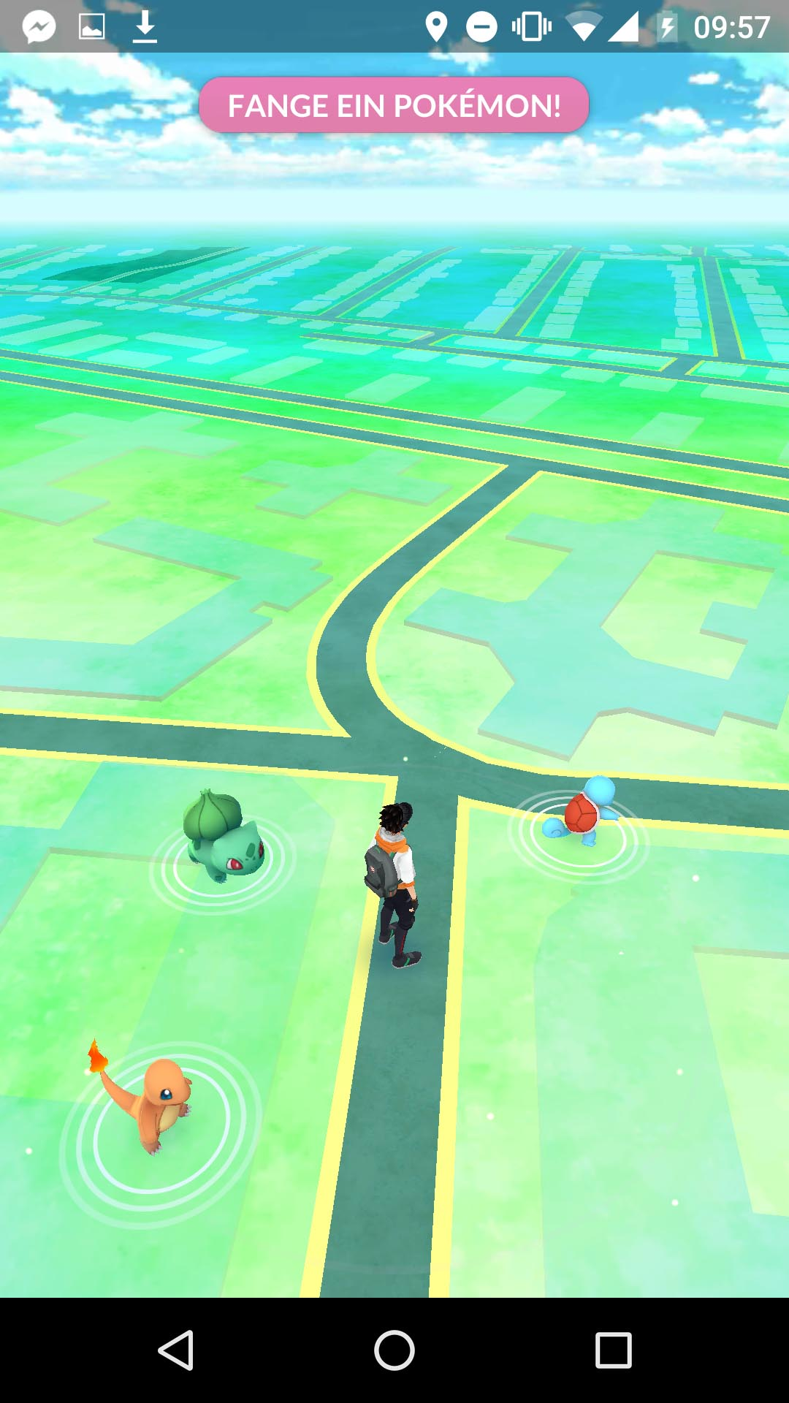

Slide 37
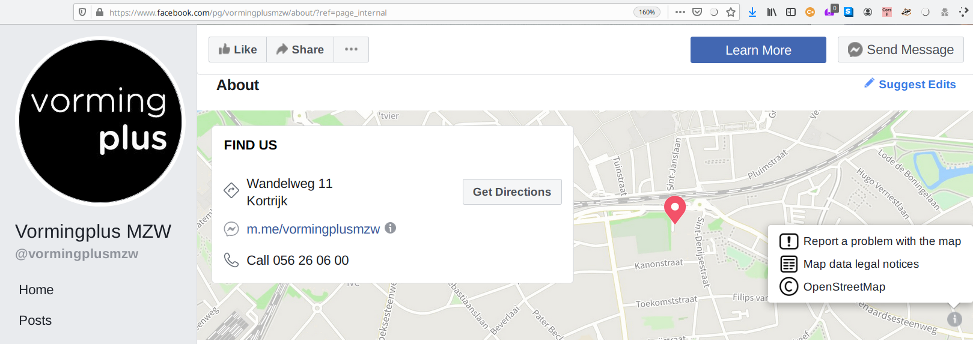


Slide 38
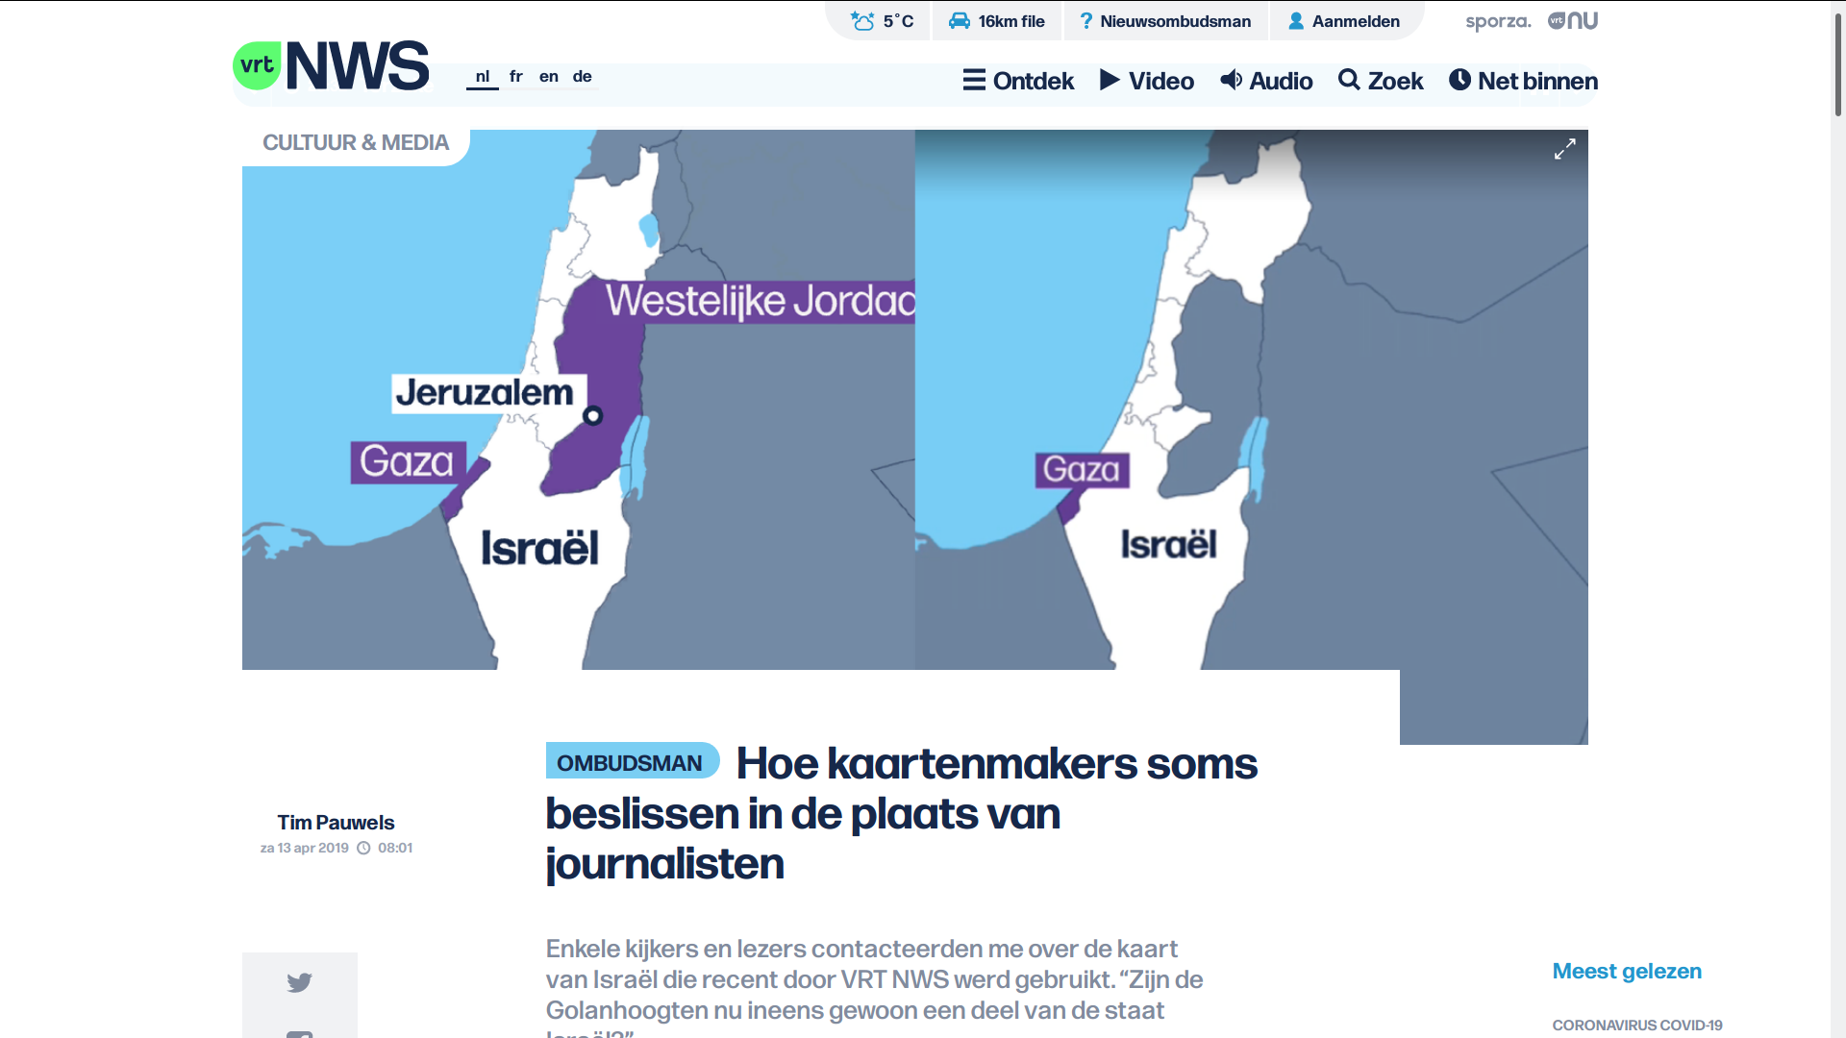

Slide 39

Szell, M. (2018). Crowdsourced Quantification and Visualization of Urban Mobility Space Inequality. Urban Planning, 3(1), 1-20. doi:http://dx.doi.org/10.17645/up.v3i1.1209

Slide 40
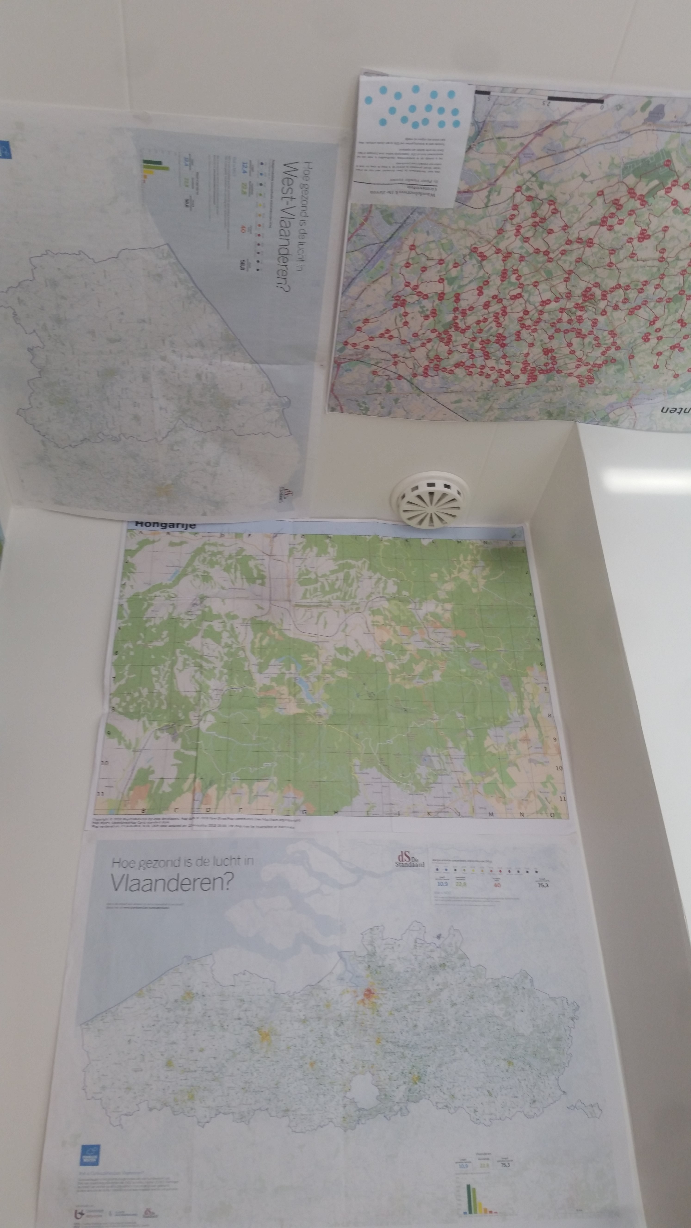
Szell, M. (2018). Crowdsourced Quantification and Visualization of Urban Mobility Space Inequality. Urban Planning, 3(1), 1-20. doi:http://dx.doi.org/10.17645/up.v3i1.1209

Slide 41
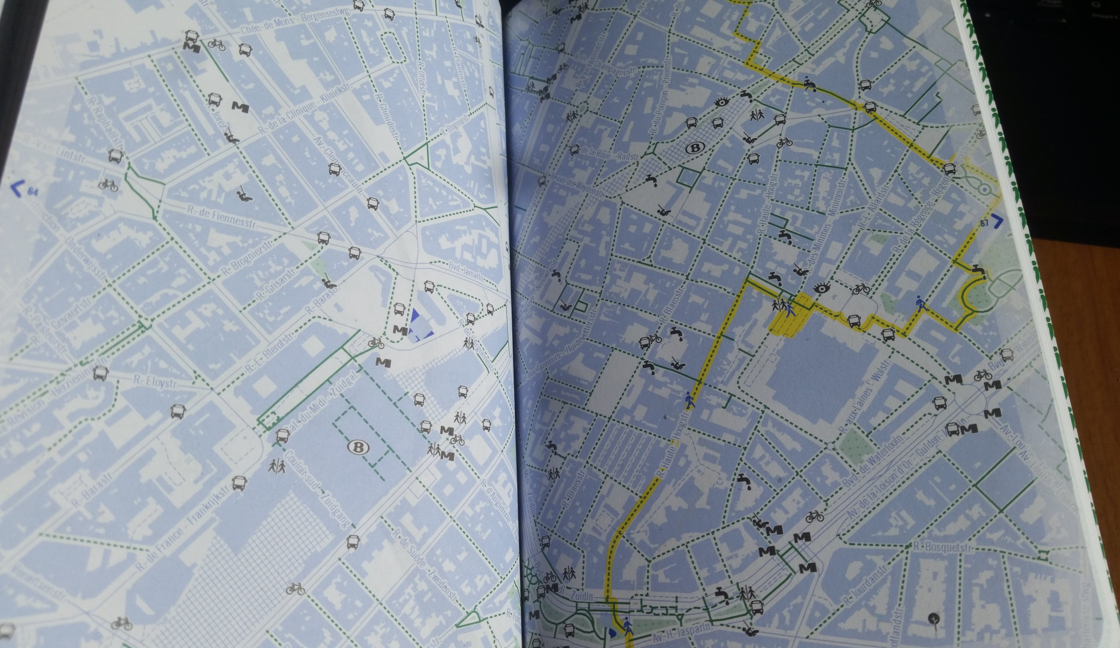


Szell, M. (2018). Crowdsourced Quantification and Visualization of Urban Mobility Space Inequality. Urban Planning, 3(1), 1-20. doi:http://dx.doi.org/10.17645/up.v3i1.1209

Slide 42
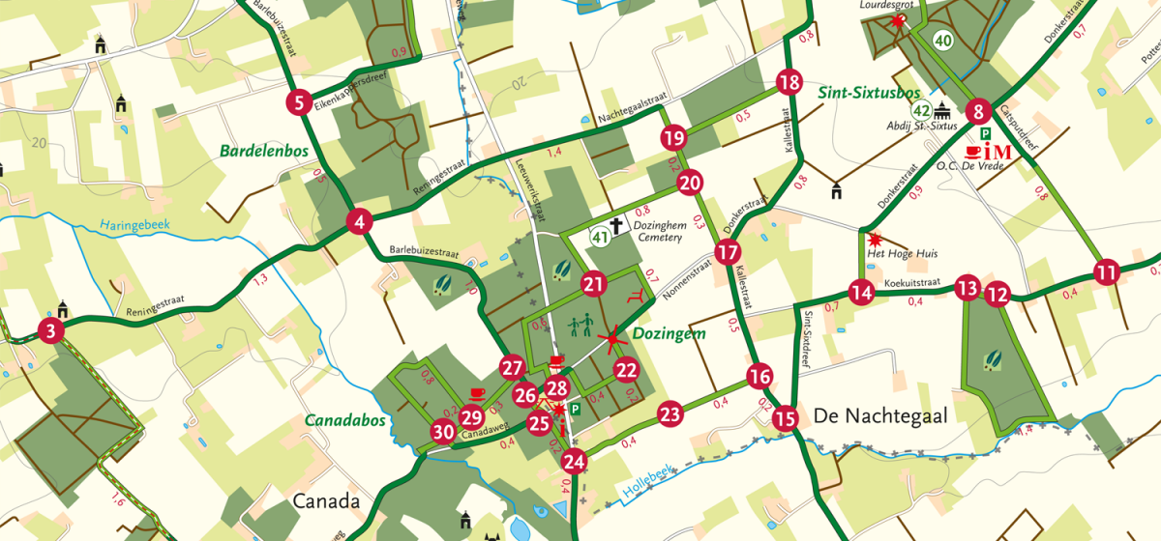

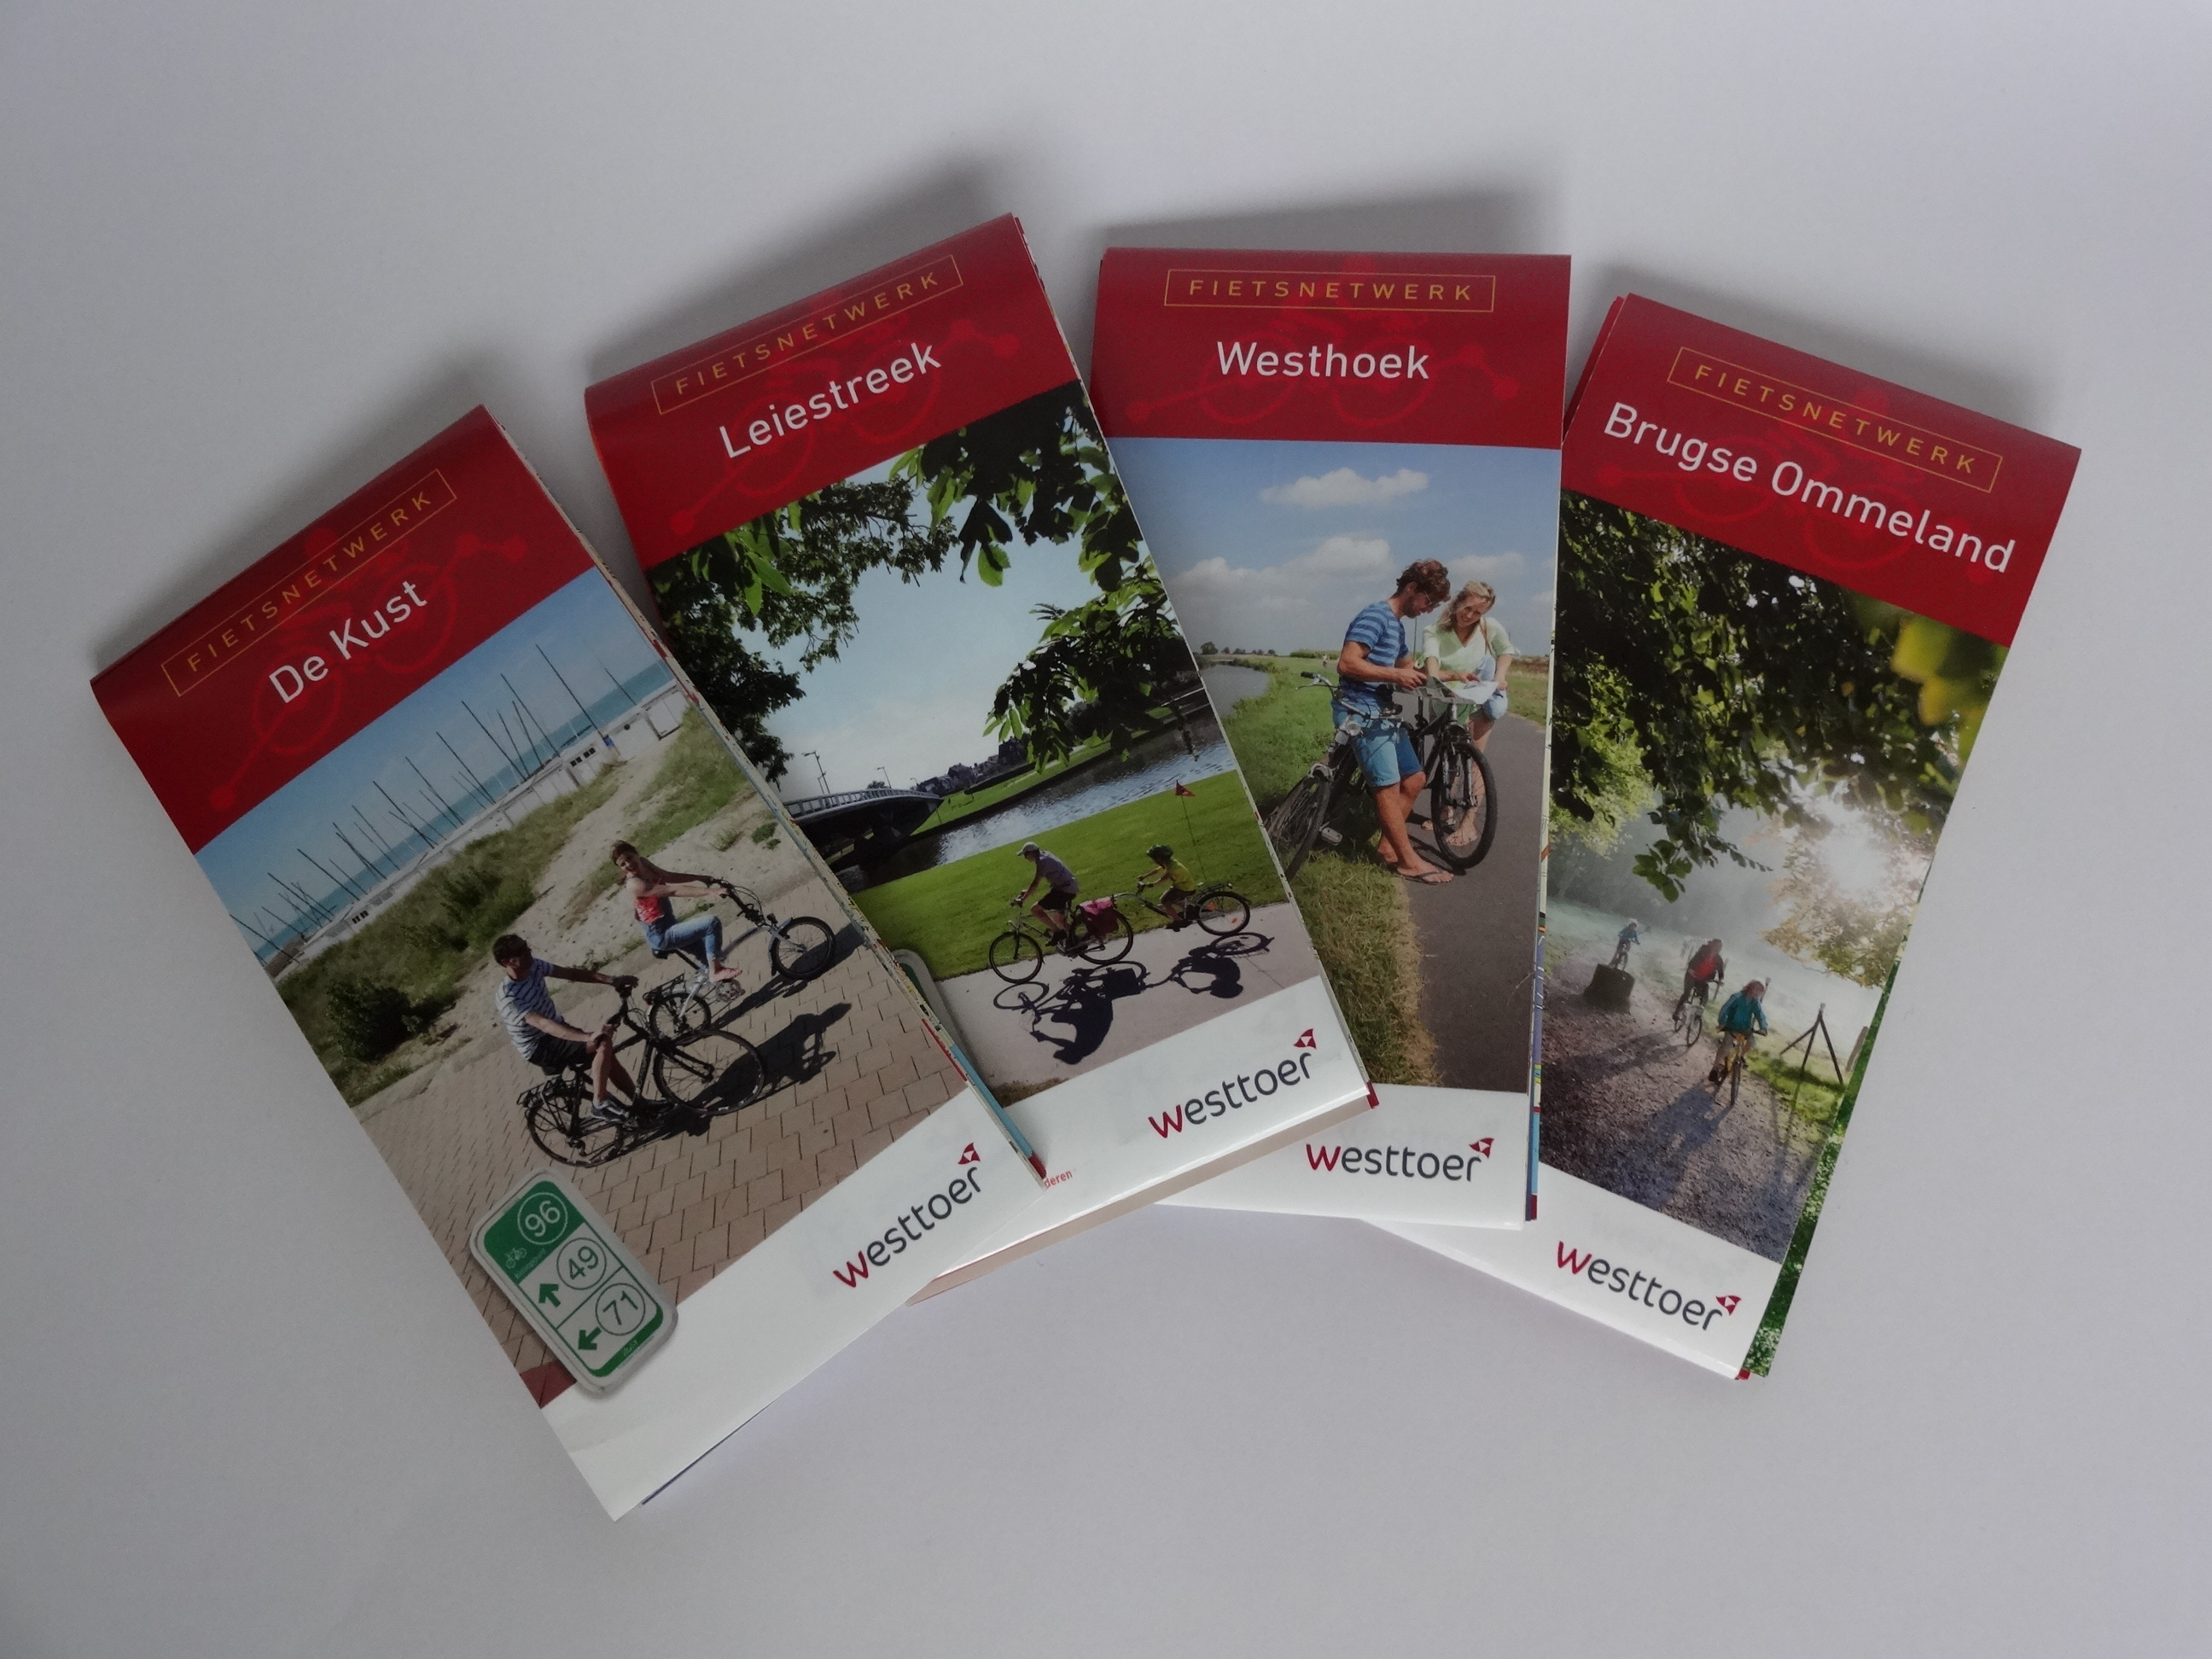
Szell, M. (2018). Crowdsourced Quantification and Visualization of Urban Mobility Space Inequality. Urban Planning, 3(1), 1-20. doi:http://dx.doi.org/10.17645/up.v3i1.1209

Slide 43
Pretty damn cool

Slide 44

What is
OpenStreetMap
NOT?

Slide 45
When did you last use a map?
Which map was it?
Why?
How much did you pay to use it?

Slide 46
Price of maintaining a map
Google Maps costs around
  ??? dollar/year

Slide 47
Price of maintaining a map
Google Maps costs around
  1 ‘000’000’000 dollar/year
  (This number is a rumor, no official sources exist)

Slide 48
Price of maintaining a map
Google Maps costs around
  1 billion dollar/year
  (This number is a rumor, no official sources exist)

Slide 49
Price of maintaining a map
Google Maps costs around
  1 billion dollar/year
  (This number is a rumor, no official sources exist)
Buying and creating satellite and map data
Google Streetview costs $200 ‘till $1150/km
Google bought Waze for 1.1 billion dollar

Slide 50
Price of maintaining a map
Similar amounts for other services
Google bought Waze for 1.1 billion dollar
Nokia bought Navteq for 8 billion dollar
and ‘burns’ 1 billion a year
Apple maps burns around 1 billion dollar/year
http://www.asymco.com/2012/12/18/how-much-to-maps-cost-and-what-are-they-worth/
http://www.asymco.com/2012/12/18/how-much-to-maps-cost-and-what-are-they-worth/

Slide 51

How much did you pay?
There is no such thing as free lunch

Slide 52


Slide 53
Notes:
Why are these shown? Why not a very recognizable spot? Such as the stations?

Slide 54

Google Maps is advertising
Google makes money by
placing ads on the map
giving some venues more priority in search
No incentive to map poor countries
“Google Maps only works within 100 miles of a starbucks”
Notes:
Who remembers this

Slide 55

Google Maps is tracking
Google tracks your searches and location through maps,
under the guise of features
“Share your location”, “Find my phone”, “Where am I?”
Very valuable information
Better ads
How effective is an ad pin?
...
Notes:
Who remembers this

Slide 56
Google Maps is a monopoly
Little incentive for other companies to provide cartography services,
cause ‘google maps is free anyways’ - the consumer
You can look to it, but not reuse anything
Google Maps uses lock-in-tricks
  Sudden price hike for devs (1th may 2018)
  Death by a thousand papercuts

Slide 57
… but
Google Maps does have more information
on shops and businesses
because everyone searches them there
(It’s even worse – a shop not on Google
“does not exist)
but this is changing!

Slide 58
… but
Google Maps does have more information
on shops and businesses
because everyone searches them there
(It’s even worse – a shop not on Google
“does not exist)
but this is changing!

Slide 59

OSM is catching up!
2007 2017

Slide 60
OSM is truly free
Free as in beer*
Free as in freedom
However, if you can afford it, donate back
Money for the server
Data – contribute yourself
Love – use it on the road and in your projects
Users – spread the word
*There are commercial, paid solutions too for heavy map users
However, as there are multiple players, it is affordable

Slide 61
What is
OpenStreetMap?

Slide 62
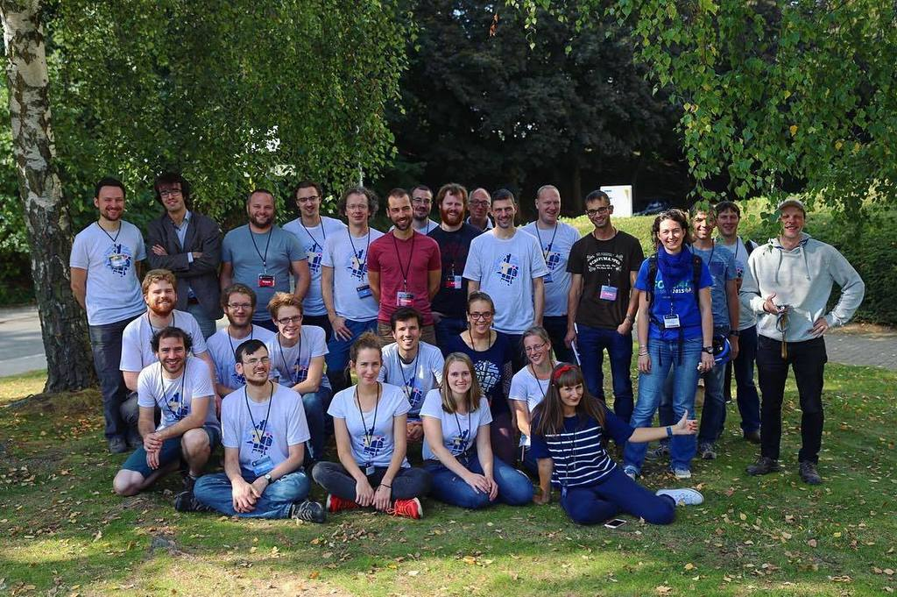

Community

Slide 63
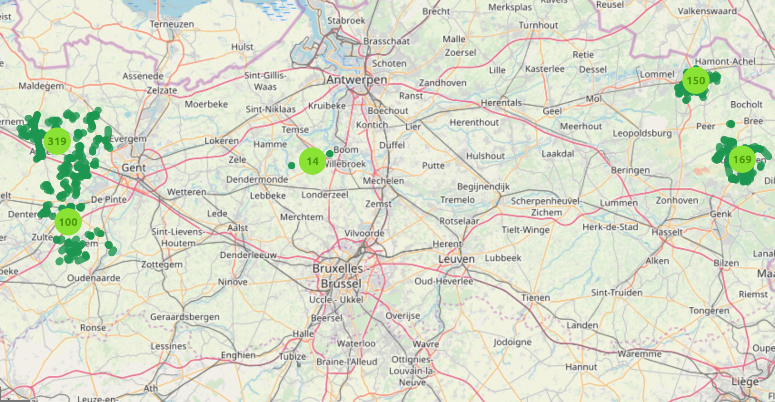
Municipality merges
A few Flemish municipalities merged on 2019-01-01
We prepared everything and had the data online

Slide 64
The Belgian community does stuff
Osm.be
Find us on meetup.com
Talk to us on riot.im (OSMBE - community)
Donate so we can buy 360° camera’s, stickers, vests, servers, …
Help our projects (map historical data, public bookcases, ...)

Slide 65
What is
OpenStreetMap?

Slide 66

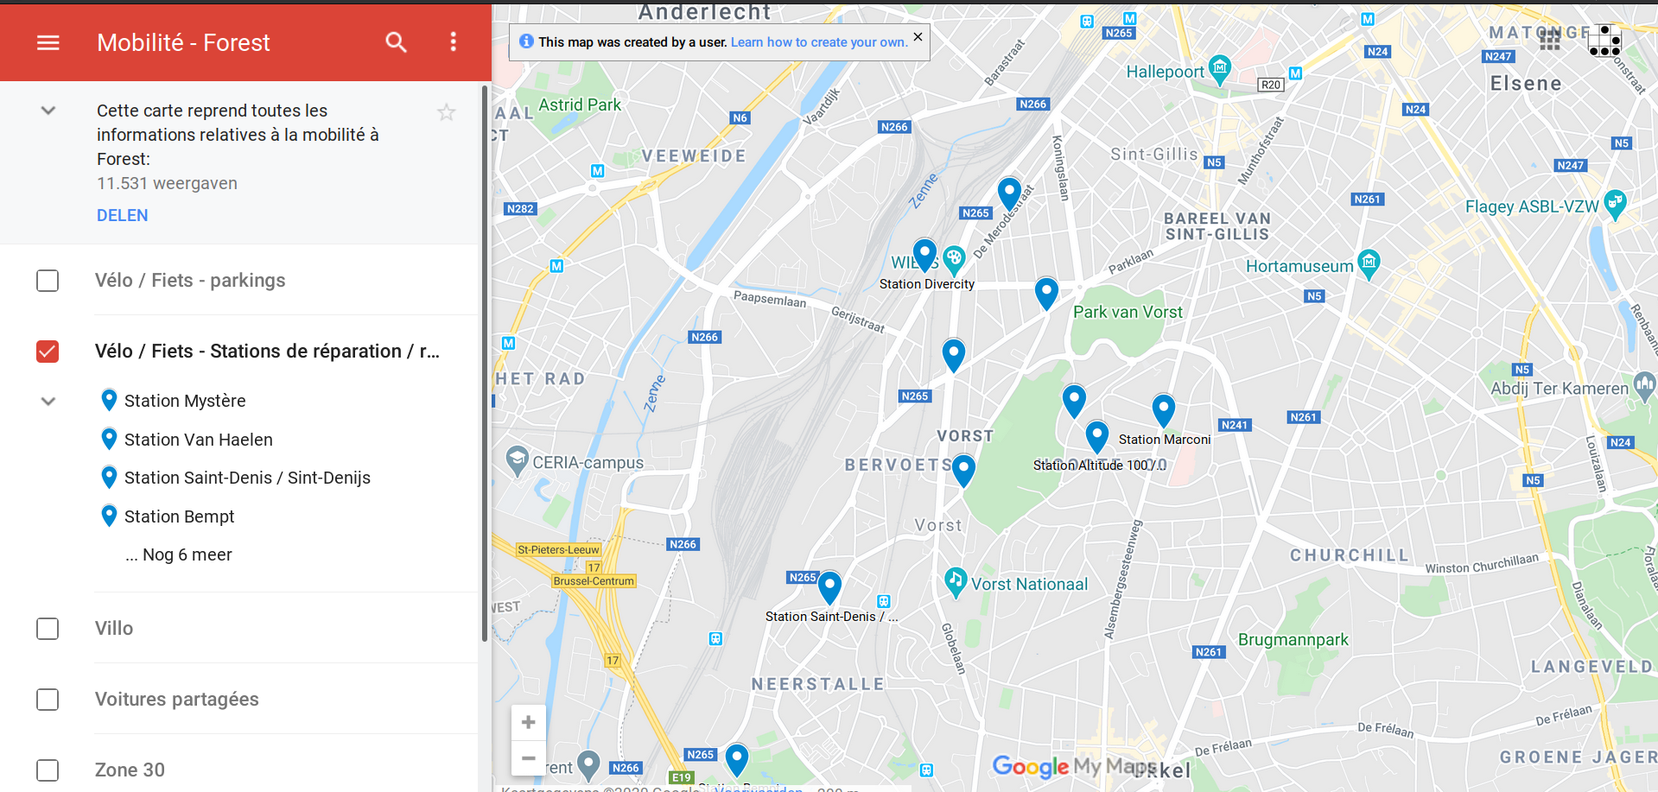
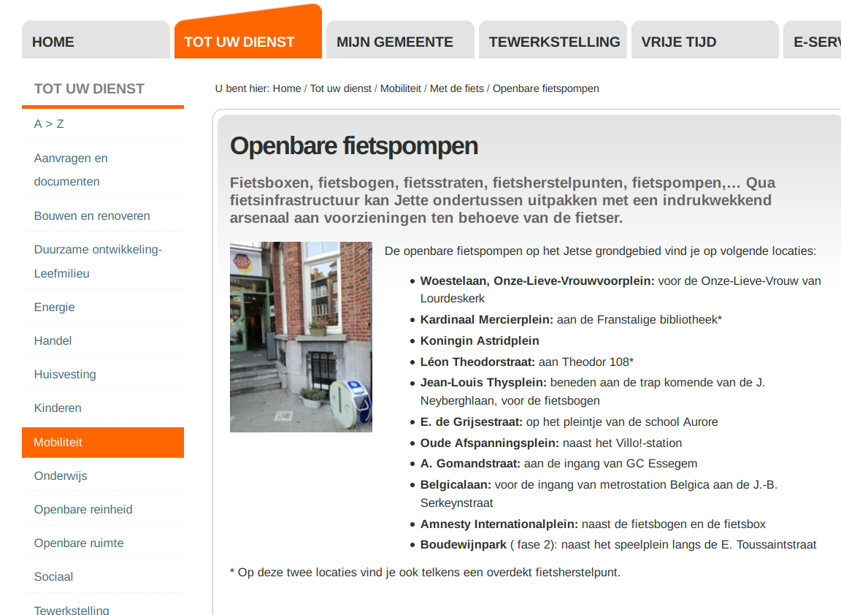
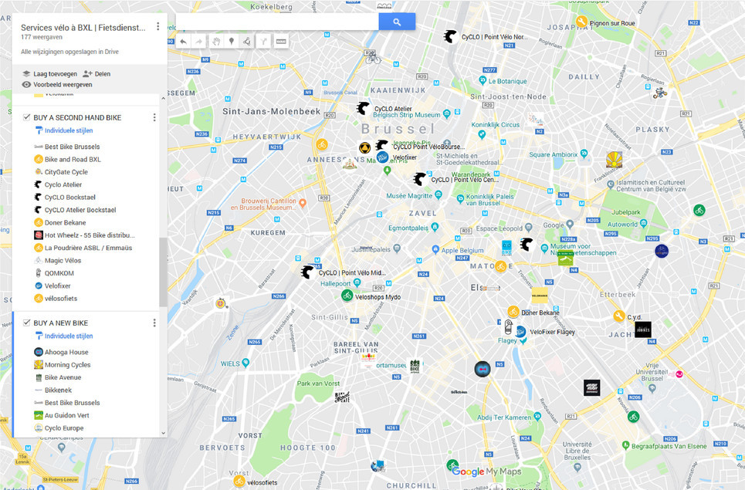

Slide 67
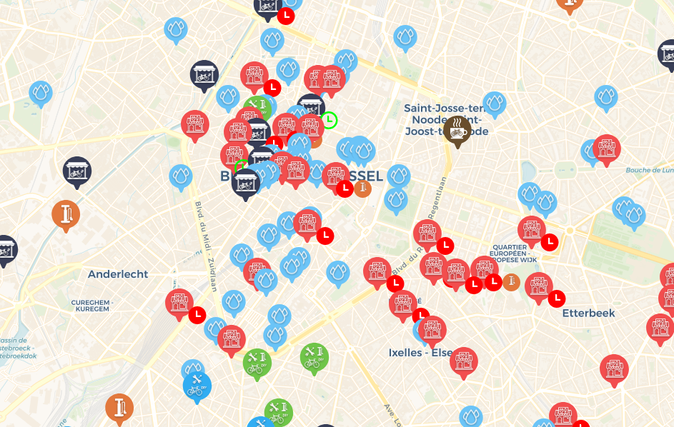

Slide 68
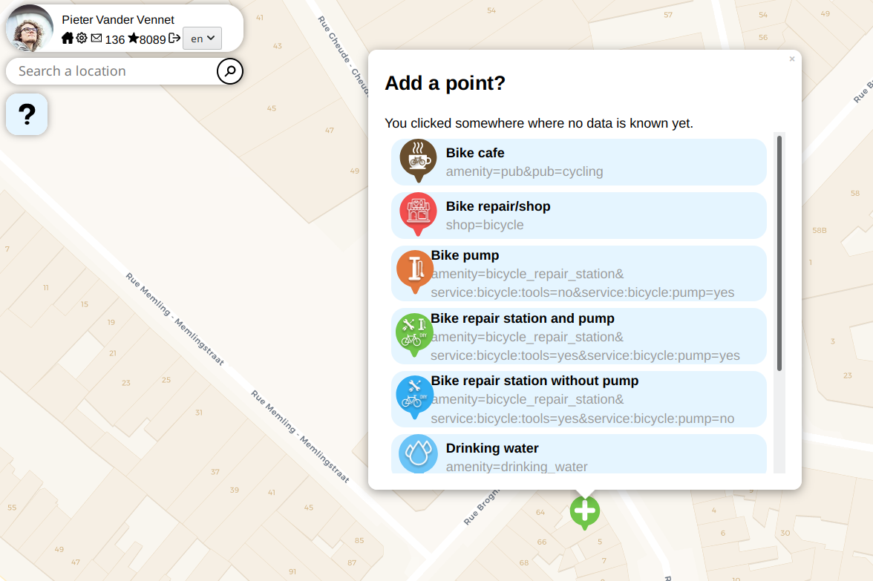

Slide 69
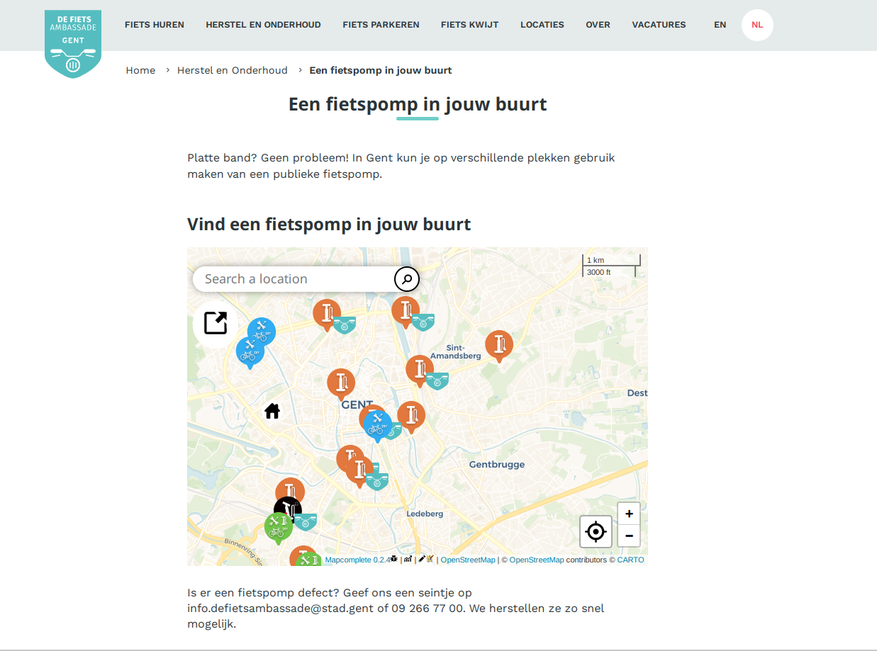

Slide 70
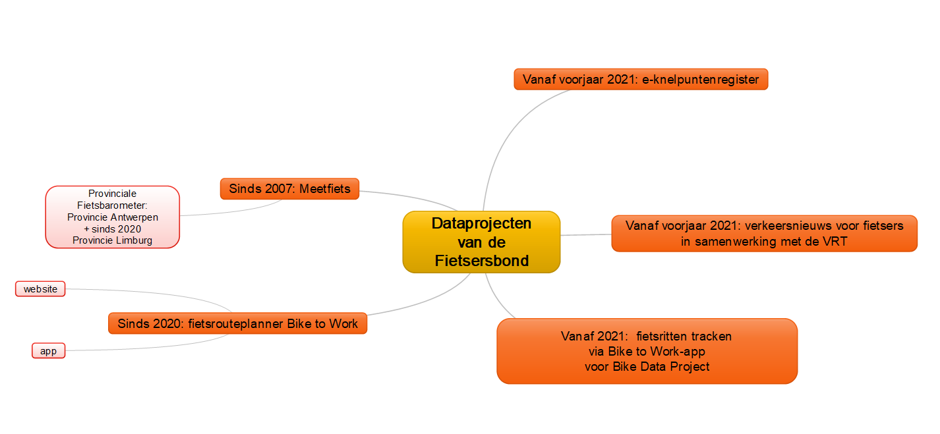
There is more!

Slide 71





There is more!
Mangrove.reviews
Mapillary.com

Slide 72
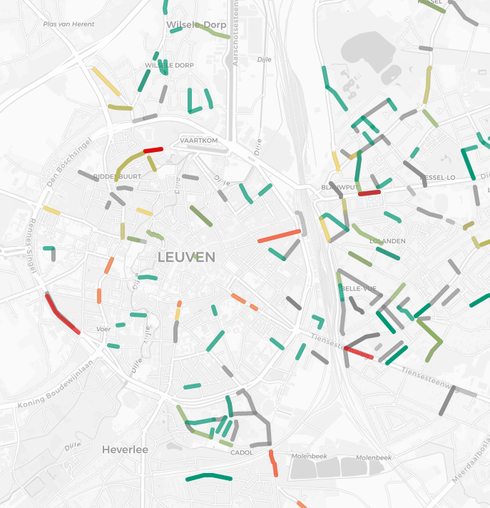


Slide 73
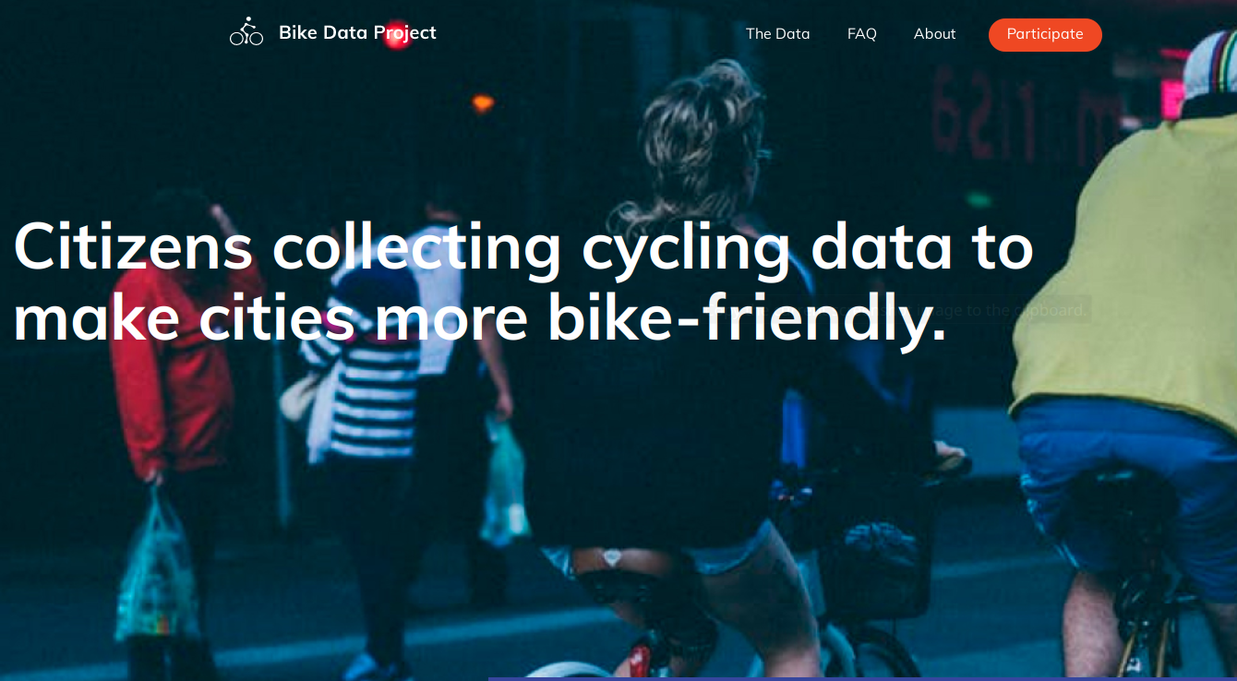
BikeDataProject.org

Slide 74
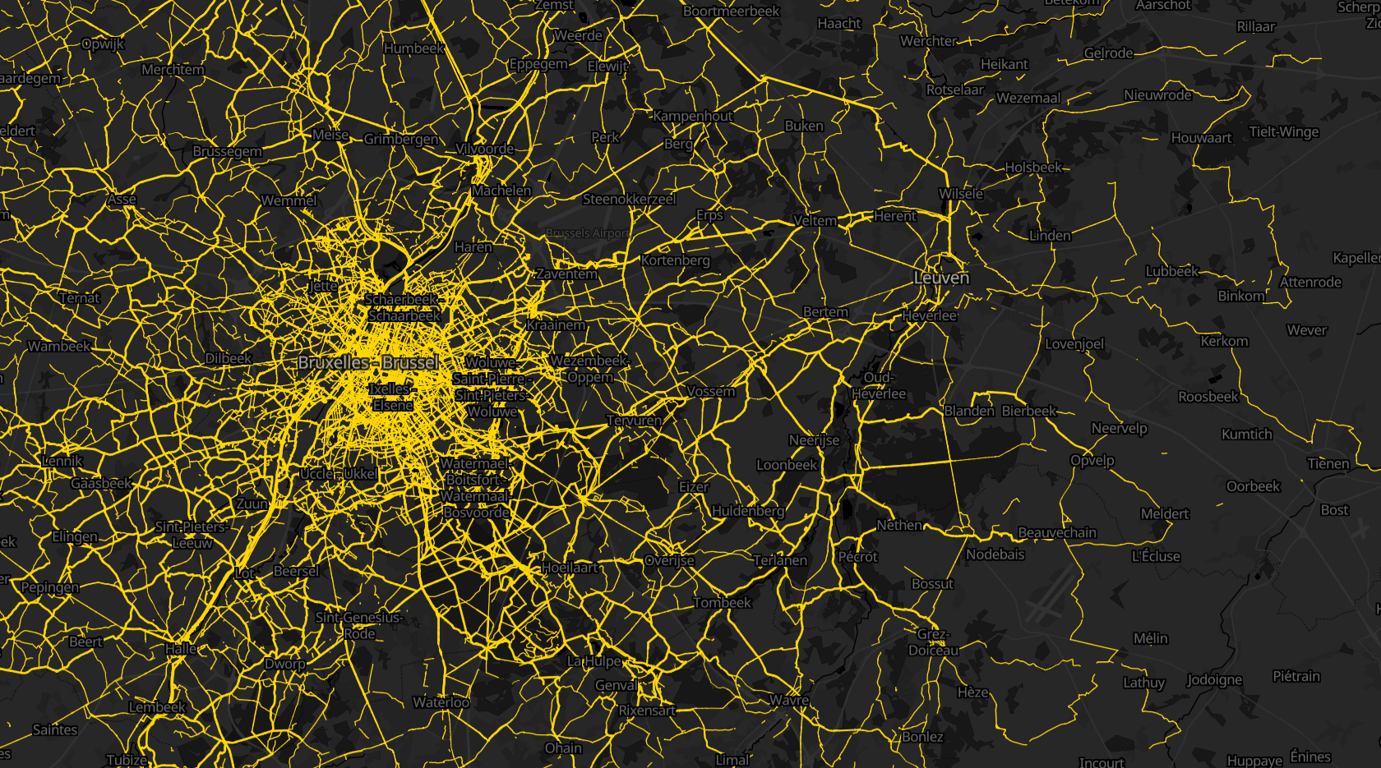
BikeDataProject.org

Slide 75
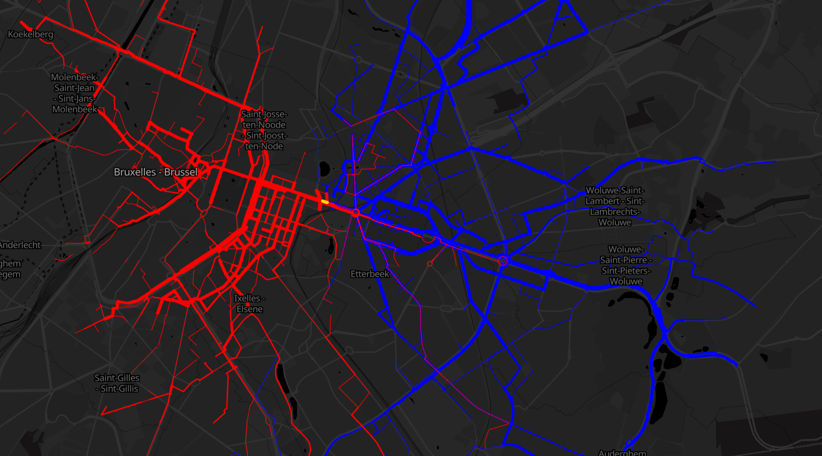
BikeDataProject.org

Slide 76


Slide 77

Open Summer of Code
~25 teams of ~5students
One coach per team
One client per team
One challenge per team
4 weeks
100% Open data/Open source
Excellent to get a prototype!

Slide 78
Working together

Slide 79
Working together on the most accurate, most detailed most up-to-date and most open global map

Slide 80
Working together on the most accurate, most detailed most up-to-date and most open global map and I’m crazy about it

